Slide 1
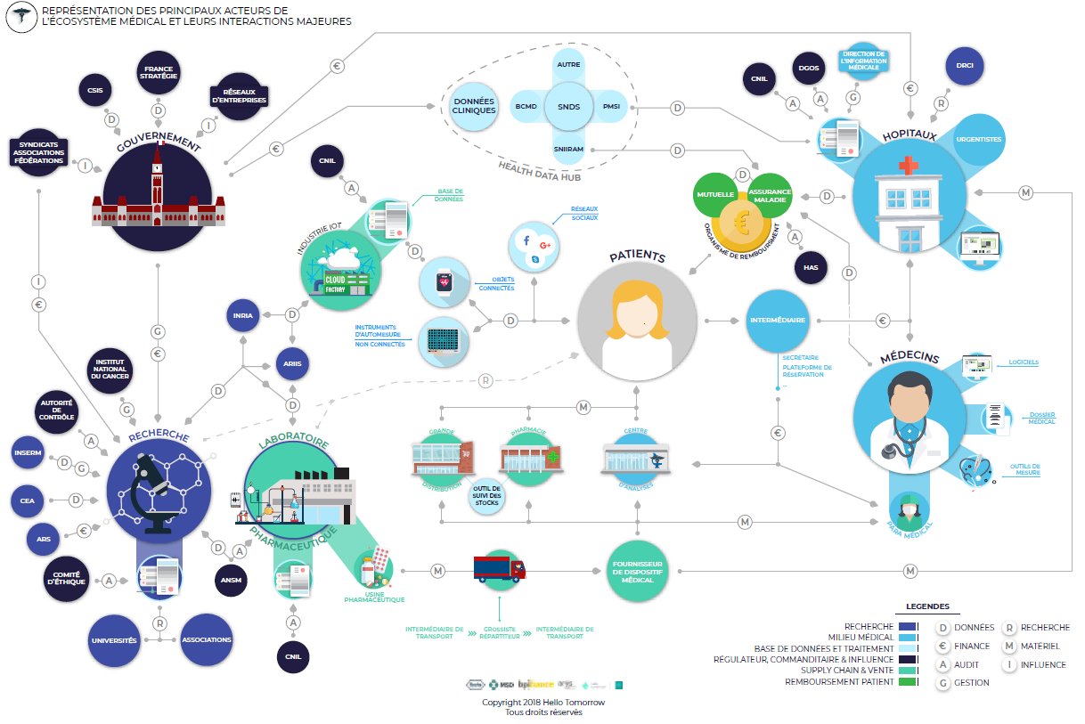

The health system big picture – A product supply & service delivery chain
From process systems engineering to business process systems engineering

Slide 2
Key features of the french Health System
A critical system in charge of maintaining life and well being
A highly regulated and controlled system at a national level
A social insurance subsystem based on solidarity and massive inclusion
A very segmented overall organisation, mainly based on medical specialities and with a large set of entities which are allowed to take care about people (from clinical activities to more social ones)
A new political envision based on the concept of patient pathways (1) to promote a user centric spirit & (2) to overcome institutional nomadism and breakdown of care continuity
A complexity to mitigate with made by a mix of uncertainty, instability, networked assets and dynamical emergence of unexpected phenoma all along the pathways
You say : Management ?

